Slide 1
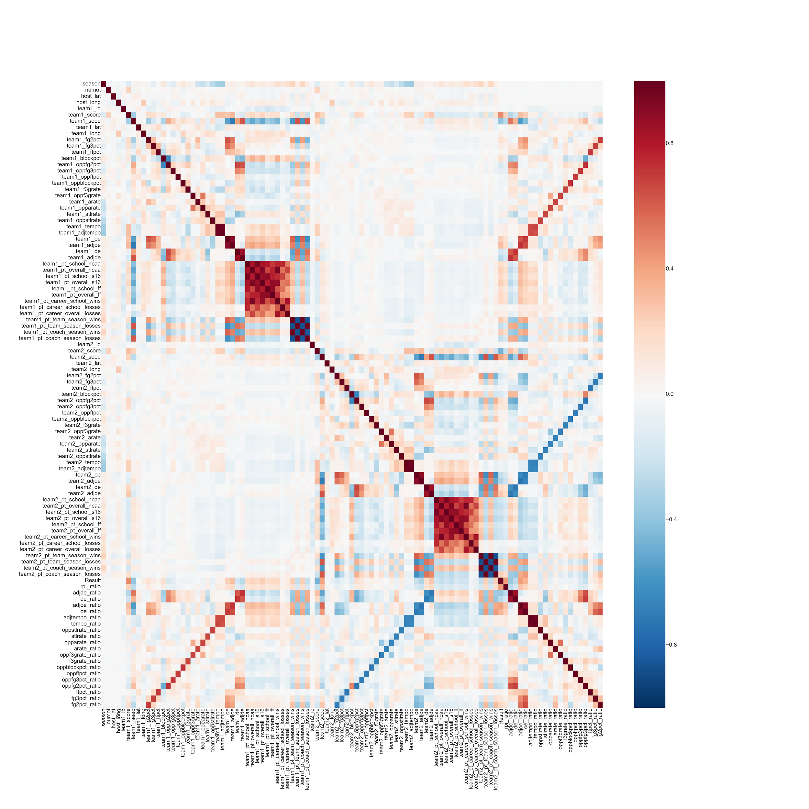
Feature Selection
We started with a correlation matrix.
Many positive and negative covariances, need for feature selection.

Slide 2
Variable selection
RFE(recursive feature elimination): Select features by recursively considering smaller sets of features, features with smaller weights are pruned from the current set features.
Pyth(pythagorean winning percentage): Derived from (AdjO^11.5)/(AdjO^11.5+AdjD^11.5)
Independent variable: Team1_pyth, Team2_pyth, Team1_rpi, Team2_rpi
Dependent variable: Result

Slide 3
Model Selection
Accuracy and Log loss for training dataset (2002 - 2015 season)
Model | Accuracy | Log loss
K nearest neighbors | 79.17% | 0.1965
Naive Bayes | 80.00% | 0.2336
Decision Tree | 74.17% | 0.1421
Logistic Regression | 77.10% | 0.2439
Random Forest | 78.33% | 0.1065
Bag Classifier | 76.25% | 0.1847

Slide 4
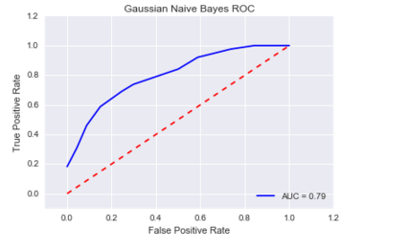
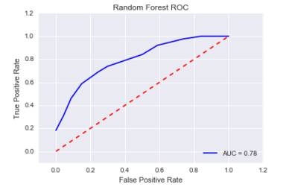
Model Selection
Area under the Curve of ROC (AUC ROC)
We use AUC to select the model that performs best on training data.

Slide 5
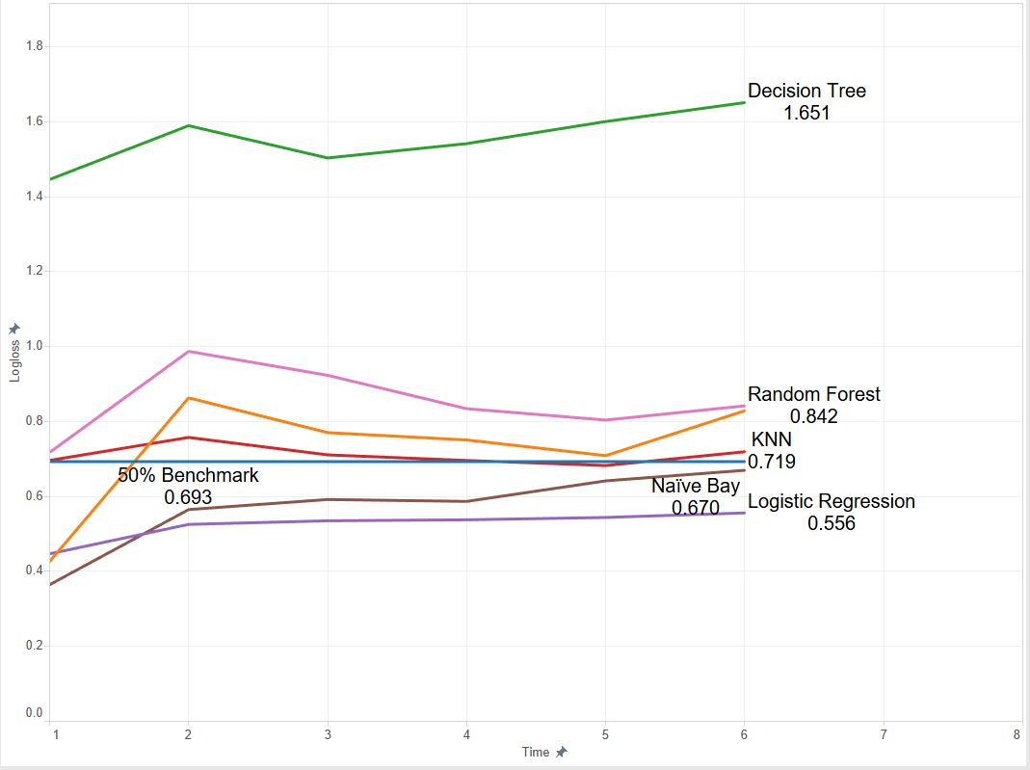
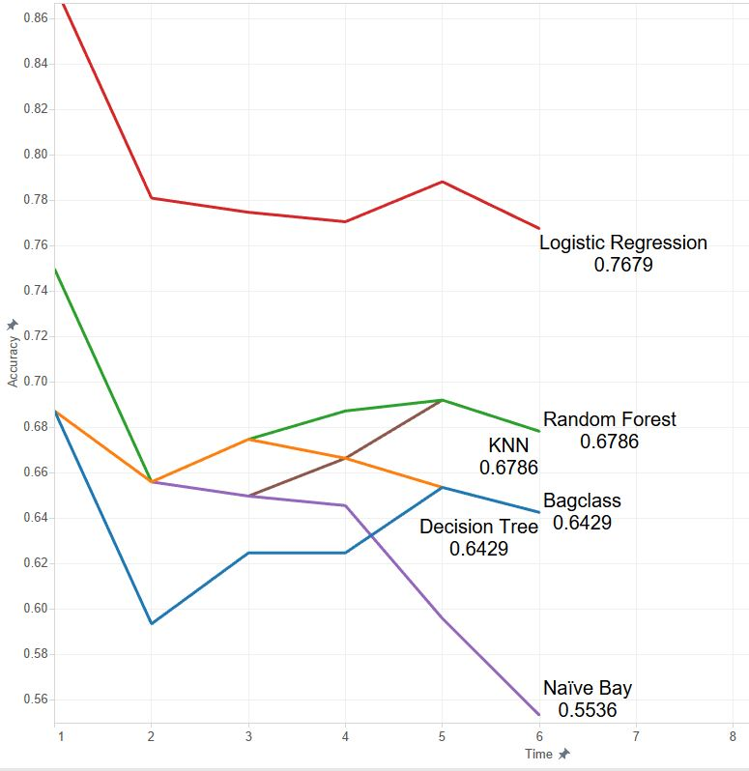
Model Performance -2016 Prediction
Log loss per day
Accuracy per day
The data of 2016 March Madness is collected before March 26.

Slide 6
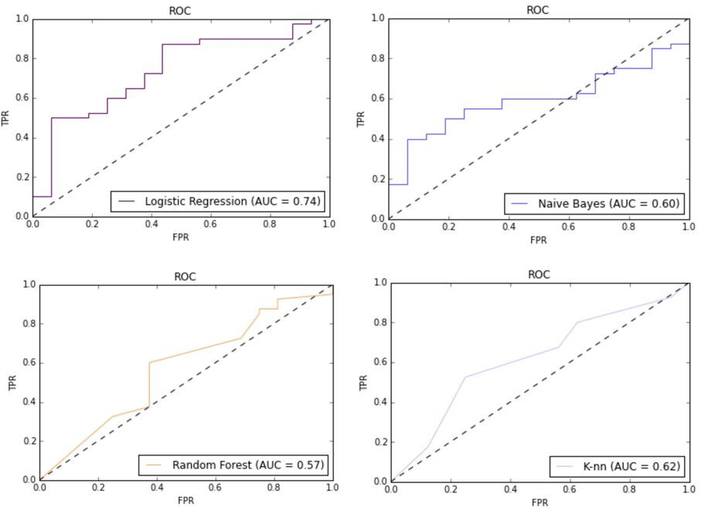
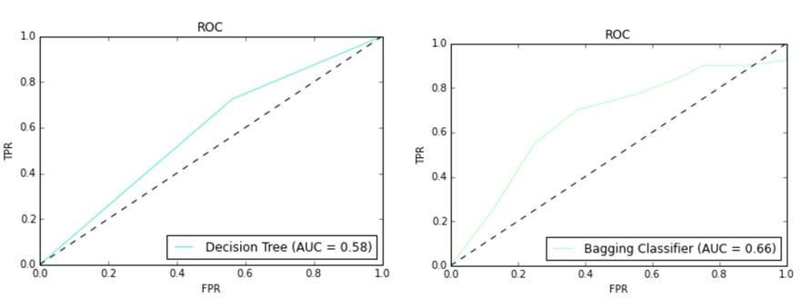
Model Evaluation
Area under the Curve of ROC (AUC ROC) of each model.
Among the six models we used, the logistic regression model performs the best.

